Slide 1


Notes:
Hello! My name is Meng Jiang. I am an assistant professor at the University of Notre Dame. As you can see, we have a beautiful campus. We are in South Bend, Indiana. It is within one and a half hours drive from Chicago. You are welcome to visit Notre Dame when the pandemic is over.

Slide 2
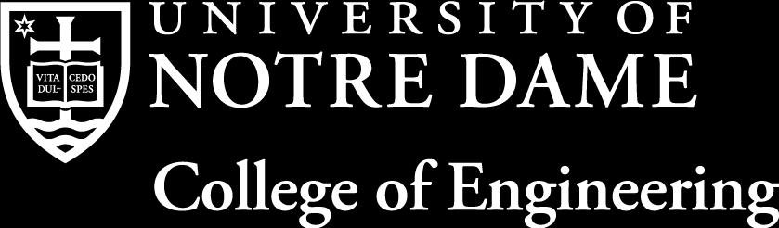
Graph Learning for Behavior Modeling
“While I may be the first woman in this office, I will not be the last, because every little girl watching tonight sees that this is a country of possibilities.” —— Kamala Harris, Vice President-Elect of USA
Meng Jiang, Ph.D.
mjiang2@nd.edu
Computer Science & Engineering
University of Notre Dame
Notre Dame, IN 46556, USA
Notes:
The topic of my talk is Graph Learning for Behavior Modeling. Let me first introduce a bit about myself and this topic.

Slide 3
About Me
Research: Directing DM² Lab (Data Mining towards Decision Making Lab)
Teaching: 40647 Data Science, 60326 Computational Behavior Modeling
Online Behavior
Target advertising, RecSys, QA, etc.
User Generated Content
Preference
Social Interaction
Suspicious Intention
Spatiotemporal Context
Graph Learning
Graph representation learning
Graph anomaly detection
Dynamic graph analysis
Text
Graph
Knowledge graph
Information extraction
Unstructured
Structured
Text generation
Natural Language Processing
Notes:
I am the director of DM square lab. Our lab’s full name is Data Mining towards Decision Making. Our goal is to design algorithms to mine and learn big data so they can help people and systems make a better decision.
At Notre Dame, I teach a fundamental course on data mining and machine learning for undergraduates. I also teach a graduate-level course called Computational Behavior Modeling.
OK. Why do we analyze and model behavior data? Because behavior data has rich information to help improve the performance of many applications, such as target advertising, recommender systems, and question answering.
Behavior data is complex. Besides user generated content, there are user preferences, social relations, and suspicious intentions. All these factors have impact on user behavior. And they are all about interactions BETWEEN user and user, BETWEEN user and content, AT particular time and location.
You know, GRAPH has nodes and links. So it can be a good structured form to represent the interactions. Researchers develop a field called graph learning to study problems such as graph representation learning, graph anomaly detection, and dynamic graph analysis for behavior modeling. These are going to be the central topic of my talk today.
On the other side, the content is unstructured WHEN it’s text data. So if we could EXTRACT structured information from the text AND BUILD a knowledge graph, we would be able to apply graph learning on the content data. That’s from the left to the right. And if an algorithm discovered something interesting from graphs, then generating a textual form of it can help people understand that discovery. That’s from the right to the left. So, another research direction of my lab is natural language processing. Specifically we are interested in information extraction and text generation.

Slide 4
Outline
Behavior modeling: Applications
Graph learning: Machine learning tasks
Graph learning technologies
Adjacency matrix factorization
Network embedding
Graph neural network (GNN)
Advanced GNN techniques: Dynamics and anomaly detection
CalendarGNN _{Wang et al. KDD’20}
CoEvoGNN Wang et al. KDD-DLG’20 Best Paper Award
Graph Anomaly Loss for GNNs _{Zhao et al. CIKM’20}
Notes:
This is the outline of my talk today. I will briefly discuss the connection between behavior modeling and graph learning. Then we will review the graph learning technologies in the last two decades. I categorize them into three types: adjacency matrix factorization, network embedding, and graph neural network. I will talk about their representative works and discuss the advantages and disadvantages. Then at the end of the talk, I will briefly present our three recent works on graph neural network.

Slide 5
Behavior Modeling: Applications
Categorization
e.g., predict the category of customer or product
Target advertising
e.g., predict user demographic information
Recommender system
e.g., predict what product a user will purchase
Suspicious behavior detection
e.g., detect spam, fraud, and fake review
Notes:
Here I list four examples of behavior modeling applications. People are using data to predict categories, predict user demographic information, predict purchasing behavior, and detect fraud. For example, we collaborate with a company that develops a mobile app to push news articles to users. Their app also pushes advertisements such as handbags and watches. But very few users GIVE their gender and age information because of privacy reasons. So predicting that information with their behavior data can help the company to do target advertising.

Slide 6
Graph Learning: Tasks
Given graph data:
Nodes:
Node types
e.g., customer/product
Node attributes
Links
e.g., purchasing behavior
Link attributes
e.g., location and time
predict the category of customer or product
Node classification
predict user demographic information
Node attribute (value) prediction
predict what product a user will purchase
Link prediction
detect spam, fraud, and fake review
Graph anomaly detection
Notes:
Then how do we formulate and solve these application problems? We can represent behavior data as a graph. A graph has one or multiple types of nodes. It has node attribute information like user or product profiles. It also has links and link attributes like a purchasing behavior between a customer and a product, as well as the location and time.
Then we can define machine learning tasks based on the graph.
Predicting customer or product category is actually a node classification task.
Predicting user demographic information is to predict user node attribute values.
Predicting purchasing behaviors can be considered as link prediction.
And detecting spam or fraud is a graph anomaly detection task.

Slide 7
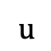
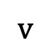
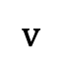
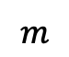
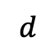
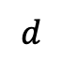
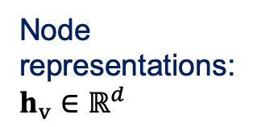
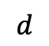
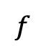
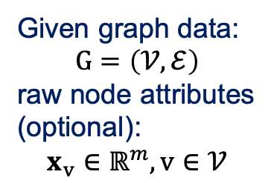
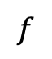
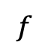
Graph Representation Learning
$$f$$
$$v$$
label
(high dimensionality, sparsity)
$$d$$
Node classification
Anomaly detection
Node
representations:
$$h_{v}∈ℝ^{d}$$
$$f$$
Given graph data:
$$G=\left(𝒱,ℰ\right)$$
raw node attributes
(optional):
$$x_{v}∈ℝ^{m}, v∈𝒱$$
Model
$$v$$
$$d$$
$$m$$
$$d$$
Node attribute prediction
often referred as
“latent features”
“node embeddings”
$$u$$
$$f$$
?
$$v$$
Link prediction
Notes:
You know, to solve machine learning tasks, we need effective features.
However, the data we have is high dimensional and sparse. Given a large graph and raw node attributes, we want to learn low-dimensional representations of nodes.
Simply say, given a node v, we are looking for 64 features or 128 features h_v. We expect this h_v to have lots of information from the graph data G so that it can accurately predict labels, attributes, and links with some simple classifiers f.
The node representation h_v is also called latent features or node embeddings. So here d is the number of latent features or the size of embedding space.
Now you can see the core problem of Graph Learning is Graph Representation Learning.

Slide 8
Graph Learning: Three Technologies
Graph neural network
NMF-RecSys
(Computer’09)
Netflix competition winner
NMF
(NeurIPS’01)
ContextMF
(CIKM’12)
GraphSAGE
(NeurIPS’17)
GAT
(ICLR’18)
HeteroGNN
(KDD’19)
SoRec
(CIKM’08)
GCN
(ICLR’17)
HeteroGAT
(WWW’19)
PMF
(NeurIPS’08)
…
Adjacency matrix factorization
2020
DeepWalk
(KDD’14)
metapath2vec
(KDD’17)
LINE
(WWW’15)
node2vec
(KDD’16)
Network embedding
Notes:
During the last 20 years, there are three types of graph learning technologies. The first type is adjacency matrix factorization. It became very popular when a factorization-based technique won the 1 million dollars Netflix competition in 2009. The second type is network embedding. I guess some of you may have heard about DeepWalk and node2vec. The third type is graph neural network. This GNN only took three years to become the mainstream framework for graph learning.
So I will briefly introduce the representative works of each type and discuss their advantages and disadvantages.
We will have a feast. I mean I will cover almost 20 papers. OK. Let’s get started.

Slide 9
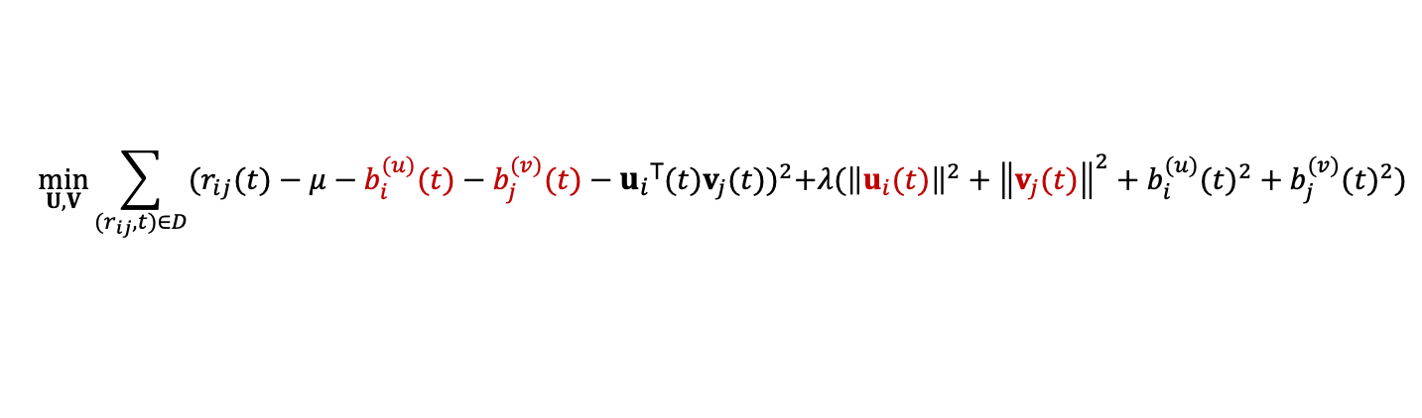
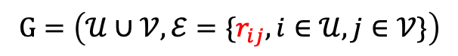
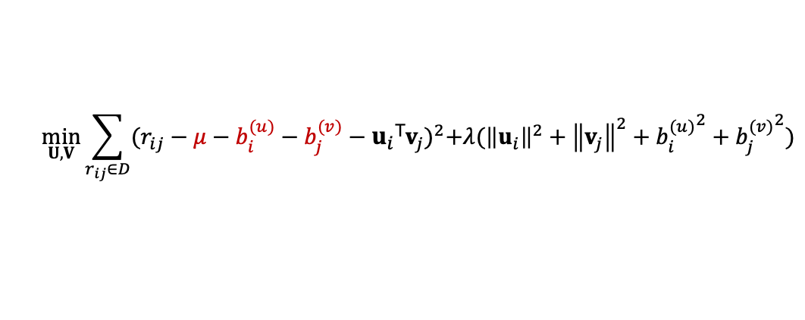
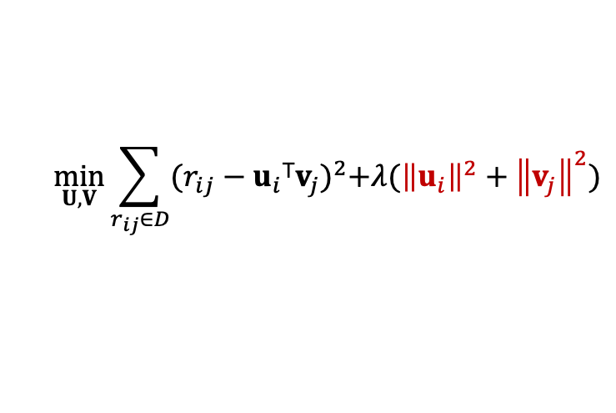
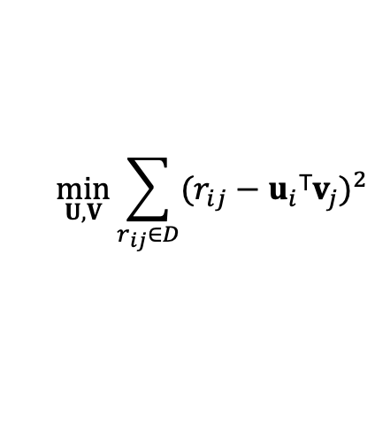
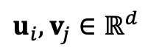
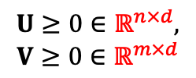
Nonnegative Matrix Factorization
NMF-RecSys (Computer’09)
Koren et al.
Netflix competition winner
$$G=\left(𝒰∪𝒱,ℰ=\{r_{ij}, i∈𝒰, j∈𝒱\}\right)$$
$$u_{i},v_{j}∈ℝ^{d}$$
or written as
$$U≥0∈ℝ^{n×d},$$
$$V≥0∈ℝ^{m×d}$$
user
item
rating
Main term:
$$\min_{U,V}{\sum_{r_{ij}∈D}{{(r_{ij}−u_{i}\text{T}v_{j})}^{2}}}$$
latent features
“Sparse coding”,
avoid overfitting:
$$\min_{U,V}{\sum_{r_{ij}∈D}{{(r_{ij}−u_{i}\text{T}v_{j})}^{2}+λ({\left\|u_{i}\right\|}^{2}+{\left\|v_{j}\right\|}^{2})}}$$
Adding “global average”, “item bias”, “user bias”:
$$\min_{U,V}{\sum_{r_{ij}∈D}{{(r_{ij}−μ−b_{i}^{(u)}−b_{j}^{(v)}−u_{i}\text{T}v_{j})}^{2}+λ({\left\|u_{i}\right\|}^{2}+{\left\|v_{j}\right\|}^{2}+{b_{i}^{(u)}}^{2}+{b_{j}^{(v)}}^{2})}}$$
Adding temporal dynamics:
$$\min_{U,V}{\sum_{{(r}_{ij}, t)∈D}{{(r_{ij}(t)−μ−b_{i}^{(u)}(t)−b_{j}^{(v)}(t)−u_{i}\text{T}(t)v_{j}(t))}^{2}+λ({\left\|u_{i}(t)\right\|}^{2}+{\left\|v_{j}(t)\right\|}^{2}+{b_{i}^{(u)}(t)}^{2}+{b_{j}^{(v)}(t)}^{2})}}$$
Notes:
First of all, nonnegative matrix factorization for movie recommendation. It represents movie rating data as a bipartite weighted graph. You can see U for users and V for movies. The goal is to learn the latent features of users and movies U and V with the adjacency matrix R. If you look at the size of U and V, you can see the data has n users and m movies, and the number of latent features is d. d can be 50 or 200, much smaller than n and m.
The idea is to minimize the reconstruction error so that information in the matrix R can be preserved into U and V.
Then the authors add more and more regularization terms into the optimization to improve the performance.
For example, they argue the latent features should be sparse to avoid overfitting. They assume a user usually has only a few favorite movie topics, not as many as 50 or 200.
Then next, they assume some movies can naturally have high ratings or low ratings, and some users may give high ratings or low ratings to all the movies. So they introduce item bias and user bias.
Then the authors further introduce temporal dynamics. They assume user’s interests may evolve over time. You can see u(t) and v(t) in the function.
The final optimization function is really complicated. But next page will let you know it performs pretty well.

Slide 10
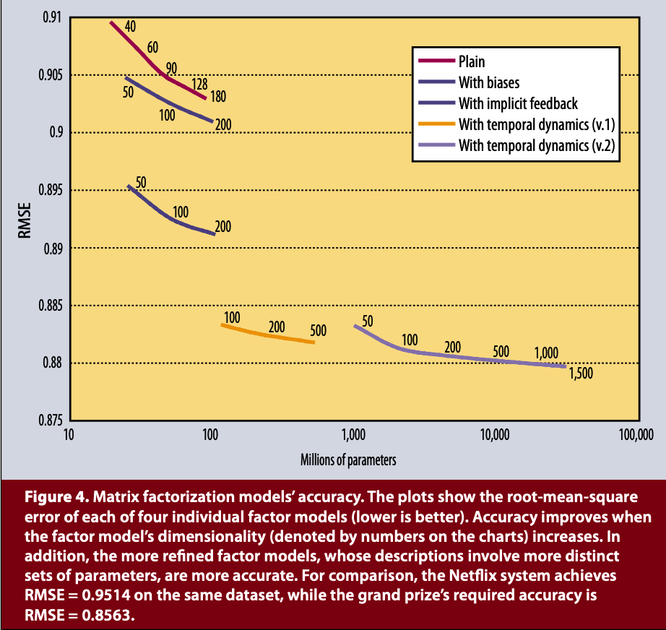
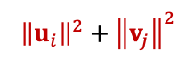
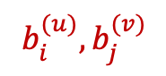
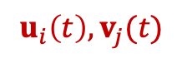
Results
$${\left\|u_{i}\right\|}^{2}+{\left\|v_{j}\right\|}^{2}$$
Error (RMSE):
Smaller means better.
$$b_{i}^{(u)},b_{j}^{(v)}$$
$$u_{i}\left(t\right),v_{j}(t)$$
Notes:
The evaluation measure is RMSE. So smaller is better. As you can see, with sparse regularization, then with user bias or item bias, then the temporal dynamics, the error decreases step by step. So incorporating reasonable regularizations into the factorization model does improve its accuracy.

Slide 11
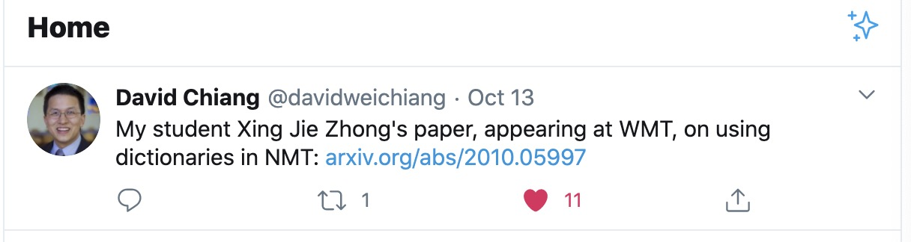
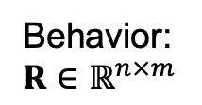
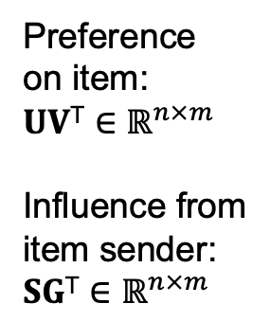
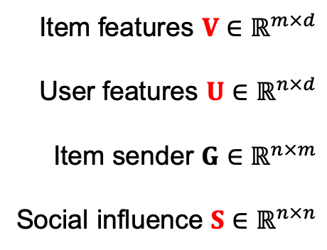
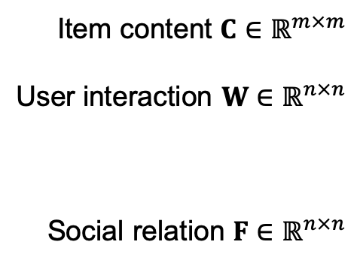
Social Contextual Recommendation
ContextMF (CIKM’12, TKDE’14)
Jiang et al. (cited by 315 and 147 times)
Google Scholar 10/15/2020
Problem: The conversion rate of Weibo’s retweeting as 5.8%. Why do people retweet?
Item content $C∈ℝ^{m×m}$
User interaction $W∈ℝ^{n×n}$
Social relation $F∈ℝ^{n×n}$
Item features $V∈ℝ^{m×d}$
User features $U∈ℝ^{n×d}$
Item sender $G∈ℝ^{n×m}$
Social influence $S∈ℝ^{n×n}$
Preference
on item:
$$UV\text{T}∈ℝ^{n×m}$$
Influence from
item sender:
$$SG\text{T}∈ℝ^{n×m}$$
Behavior:
$$R∈ℝ^{n×m}$$
$$\min_{U,V,S}{{\left\|R−SG\text{T}⨀UV\text{T}\right\|}_{F}^{2}+α{\left\|C−VV\text{T}\right\|}_{F}^{2}+β{\left\|W−UU\text{T}\right\|}_{F}^{2}+γ{\left\|F−S\right\|}_{F}^{2}}$$
Notes:
Let me talk about one of my early work with Weibo. Weibo is a microblogging platform in China. It’s like Twitter. This work is to develop a factorization model for recommending tweets.
The motivation is if a system can predict what tweets a user may like and share, it can put them at the top of the feeds. Then the user will become more active on the platforms, spend more time, and more likely will see and click ads. So a social recommender system is important for Weibo’s revenue.
But the situation was, their conversion rate was only 5.8%. It means when users log in or refresh the pages to receive a list of tweet feeds ONE hundred times, they retweet fewer than six messages. If we want to improve this rate, we need to think about why do people retweet on the platform.
Here is an example. My colleague Prof. David Chiang. He posted that his student recently got a paper accepted about Machine Translation. Honestly, I was good with the topic but not very excited, because I do not work on translation. And I did saw his student tweeted the same thing earlier. I didn’t share the student’s tweet but I shared David’s tweet. Why? It’s because on social platforms, not only personal preference decides your behavior but also interpersonal influence. You know, this is quite different from movie recommenders.
So my idea is to assume that when both preference and influence are at a certain level, people will retweet. The behavior matrix should be a Hardmard product of two things. One is UV. It is for personal preference on the item. The other is SG. We need to learn S. S is the interpersonal influence. SG is the influence from the item sender. So we have this new reconstruction term.
The optimization should also use other types of available information such as content C, user interaction frequency W, and social relation F to alleviate the sparsity issue of the behavior matrix R. For example, C is a tweet similarity matrix based on bag of words. The second term assumes tweets of similar words should have similar features.
We name our model ContextMF.

Slide 12
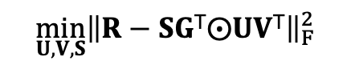
Results
Offline hold-out validation:
$$\min_{U,V,S}{{\left\|R−SG\text{T}⨀UV\text{T}\right\|}_{F}^{2}}$$
 | MAE | RMSE
Content-based | 0.2576 | 0.3643
Item-based CF | 0.2375 | 0.3372
NMF-RecSys | 0.2256 | 0.3325
InfluenceMF | 0.2183 | 0.3206
PreferenceMF | 0.2111 | 0.3088
ContextMF | 0.1514 (-24.2%) | 0.2348 (-20.7%)
Influence
Preference
A/B test: The conversion rate of Weibo’s retweeting was improved from 5.8% to 8.3% (+43.1%).
Notes:
Here are some results. Offline validation shows that reconstruction with both preference and influence can reduce the error relatively by 20%. As I was an intern in Weibo, I was fortunate to work with Weibo’s data scientists for online testing. We improved the conversion rate to 8.3%. This is a very significant improvement.

Slide 13
Adjacency Matrix Factorization: Pros and Cons
Pros
Easy to design effective main terms based on domain expertise
Easy to design regularization terms to (1) avoid overfitting and (2) incorporate auxiliary information to address the data sparsity issue
Easy to optimize using Gradient Descent methods
Cons
All are linear transformation, but the real world may not be “linear.”
Idea
Neural network with non-linear layers, e.g., “word2vec”
Notes:
Let’s discuss the pros and cons of factorization-based graph learning models.
First of all, it is easy to design main terms and regularization terms based on domain knowledge. It’s easy to incorporate additional information.
However, all the terms perform linear transformation but the relationship between nodes may NOT be linear.
How can we model non-linear relationship? Any idea?
Yes – neural networks. Because neural networks have non-linear functions and layers.
In 2013, Google’ word2vec opened people’s mind about using neural nets to learn representations.

Slide 14
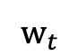
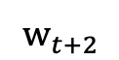
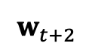
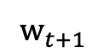
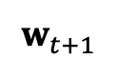
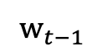
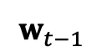
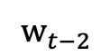
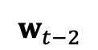
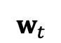
Shallow Neural Networks
word2vec (NeurIPS’13)
Mikolov et al. (cited by 23128 times)
Google Scholar 10/15/2020
neural
network
with
layers
.
neural
network
with
layers
.
$$w_{t−2}$$
$$w_{t−2}$$
$$w_{t−1}$$
$$w_{t−1}$$
$$w_{t}$$
$$w_{t}$$
non-linear
non-linear
$$w_{t+1}$$
$$w_{t+1}$$
$$w_{t+2}$$
$$w_{t+2}$$
Continuous Bag-of-Words (CBOW)
Skip-gram
Notes:
The idea is, given a sentence, if we mask one word, for example, we mask this word “non-linear”, if the neighboring words, I mean these words’ latent features can predict the masked word, then the semantics of the words are well embedded into these feature vectors. And these feature vectors are called “word embeddings”. These features can be used for document classification, clustering, and so on. Given a huge corpus, word2vec can produce effective word embeddings from sentences.
But now we have a huge graph. How can we learn node embeddings, not word embeddings? Yeah - we can consider nodes as words. Then the question is what are the sentences on a graph?

Slide 15
Network Embedding
DeepWalk (KDD’14)
Perozzi et al. (cited by 3911 times)
Google Scholar 10/15/2020
Sampling
random
walk
Training
skip-gram
model
Node
embeddings
“sentences”
Notes:
The idea is random walk. The path from node to node through a random walk can be considered as a sentence.
In 2014, the authors of DeepWalk proposed this idea. They show that a single non-linear layer on random-walk sentences can learn effective node embeddings.
Basically, two embeddings would be similar if the nodes are reachable within random walk.
This is an interesting structure that the node embeddings can preserve. But do we have any other interesting structures to preserve?

Slide 16
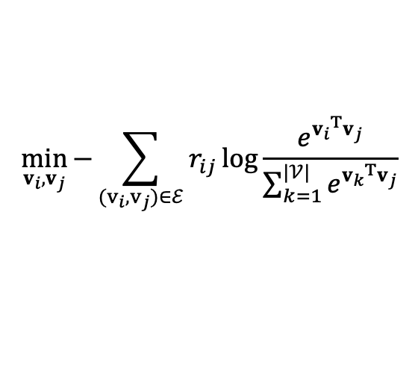
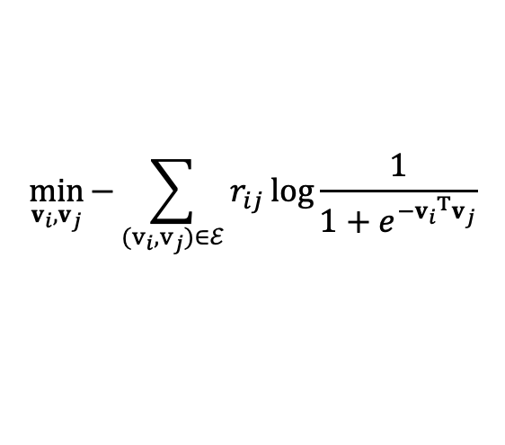
Network Embedding (cont’d)
LINE (WWW’15)
Tang et al. (cited by 2610 times)
Google Scholar 10/15/2020
Proximity
First-order
(connection)
Optimization
$$\min_{v_{i},v_{j}}{−\sum_{(v_{i},v_{j})∈ℰ}{r_{ij}\log{\frac{1}{1+e^{−{v_{i}}^{T}v_{j}}}}}}$$
negative sampling
Second-order
(sharing neighbors)
$$\min_{v_{i},v_{j}}{−\sum_{(v_{i},v_{j})∈ℰ}{r_{ij}\log{\frac{e^{{v_{i}}^{T}v_{j}}}{\sum_{k=1}^{|𝒱|}{e^{{v_{k}}^{T}v_{j}}}}}}}$$
Optimization
Notes:
How about connections? Why not just make the embeddings similar when the nodes are connected.
This is called “first-order node proximity”, in this WWW paper LINE. LINE is short for large information network embedding.
They also proposed to preserve the SECOND-order proximity.
You know, the first order is node connection. The second order is, when two nodes share more neighbors, their embeddings should be more similar.

Slide 17
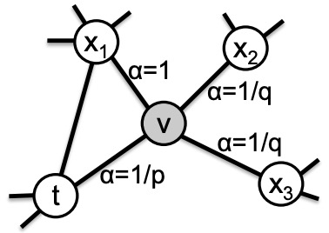
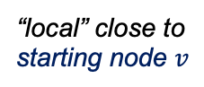
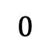
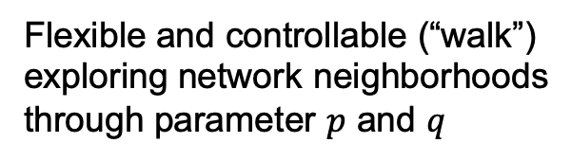
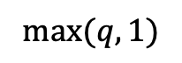
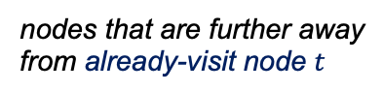
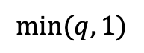
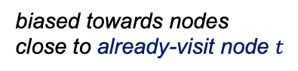




Network Embedding (cont’d)
node2vec (KDD’16)
Grover et al. (cited by 3792 times)
Google Scholar 10/15/2020
 | Cons
DeepWalk (KDD’14) | Uniform random walk: no control over neighborhoods
LINE (WWW’15) | Only breadth-first strategy Only 1-hop and 2-hop neighbors
Flexible and controllable (“walk”)
exploring network neighborhoods through parameter $p$ and $q$
“local” close to
starting node $v$
less likely
already-visit node $t$
Return parameter $p$
In-out parameter $q$
$$0$$
$$\min{(q,1)}$$
$$\max{(q,1)}$$
nodes that are further away
from already-visit node $t$
biased towards nodes
close to already-visit node $t$
$$0$$
$$1$$
Notes:
In 2016, a KDD paper called node2vec discussed the weak points of DeepWalk and LINE.
They argue that the random walk in DeepWalk is uniform so it is not flexible or controllable.
LINE is controllable. It can specify two types of node proximity but it cannot go beyond two hops.
So node2vec introduced two parameters to control the random walk.
Suppose the walker is at node v. And node t was already visited.
A smaller parameter p will more likely make the walker return to node t -- in node v’s local neighborhood
And a smaller parameter q will more likely make the walker visit nodes away from node t -- outside v’s local neighborhood.
Node2vec can preserve different types of node proximity in node embeddings by controlling these two parameters in random walk.

Slide 18





Results
Node clustering on node2vec embeddings
from Les Misérables co-appearance network
Homophily
$$p=1,q=0.5$$
DeepWalk
$$p=1,q=1$$
Structural Equivalence
$$p=1,q=2$$
Notes:
Here is an example. These nodes are characters in a famous novel book. The colors show K-Means clusters based on the node embeddings.
When q is small, the walker stays in local neighborhood. So it discovers local communities. They call this kind of node proximity “Homophily”.
When q is big, the walker goes further away. So it discovers the roles of the nodes in the graph like central hubs, social ties, and leaf nodes. They call this proximity “structural equivalence”.
Again, DeepWalk is not controllable. It is equivalent to a node2vec when p is 1 and q is 1.

Slide 19





Network Embedding (cont’d)
metapath2vec (KDD’17)
Dong et al. (cited by 675 times)
Google Scholar 10/15/2020
Heterogeneous graph/network:
Problem: Node proximity has
multiple semantic meanings.
Meta path:
A
P
A
Meta-path-based random walk
Heterogeneous skip-gram model
Heterogeneous negative sampling
A
P
K
P
A
A
A
A
P
V
P
A
$$v_{i}$$
$$v_{i}^{(t)}$$
($t$: node type)
A
P
P
A
…
Notes:
Node2vec is designed for homogeneous graph, which means the graph has only one type of nodes and one type of links.
What if we have a heterogeneous graph? Heterogeneous graph means we can have multiple types of nodes and multiple types of links.
For example, an academic graph has authors nodes, papers nodes, keyword nodes, venues nodes, and their connections. Venue means conference or journal.
Then the path between two nodes is not just about the number of hops. It can have different semantic meanings.
For example, we can have A-P-A between two author nodes. This means the two authors co-write a paper.
We can also have APKPA. It means the two authors publish papers of the same topic.
And we can have APVPA. It means they attend the same conference.
Then APPA means one author follows the other author’s paper.
These paths are called metapaths.
Metapath2vec performs meta-path-based random walk and heterogeneous skip-gram to learn the node embeddings.
This complex model can learn more semantics from the complex GRAPH DATA than node2vec.
So, it is more effective on node classification and clustering, like grouping authors into communities.

Slide 20



Network Embedding (cont’d)
TUBE (KDD’19): Embedding Behavior oUTcomes for Predicting Success
Wang, Jiang, et al.
Problem: Complementarity plays a more significant role in teaming and many other applications than Similarity/Proximity.
Project outcome
venue
goal
…
?
reference²
reference¹
?
keyword¹
Proximity learning
?
?
Preserving the complementary relationships in node embeddings
author²
author¹
Team effectiveness
Notes:
My student Daheng Wang was very interested in learning node embeddings from academic data, when he was a first-year PhD.
He did not want to GROUP authors. He wanted to know how to improve the author team to make a paper accepted by a top conference.
Suppose Daheng wants to publish a paper in KDD. Now we have two authors, me and him. We have some keywords and read some related papers.
Now the question is who can we invite to improve our team significantly.
That guy cannot be a random guy who knows nothing about KDD.
And it cannot be another first-year PhD who is similar with Daheng.
It cannot be someone who has similar knowledge and skills as I do.
We find that compared to similarity or proximity, Complementarity is more important in teaming and many other applications like choosing reading material for a course or taking multiple drugs together to cure a disease.
Suppose we see red, green, yellow, blue form a good team in training data. Proximity learning will put similar colors close in the embedding space.
Our idea is to represent the goal like the KDD conference as a point in the embedding space. We call it point of goal.
And given a team or a project plan, we start from the origin point, add the embedding vectors of team members into the route.
Red is a vector, yellow is a vector, also for blue and green.
A successful team can navigate the route to the point of goal. A bad team or a random team cannot.
In this way, we can preserve the complementarity of team members in their node embeddings.

Slide 21







TUBE: Embedding Behavior oUTcomes
$\text{p}$: project plan
g: project goal
p₂
$$ε$$
Project achievement:
$$γ\left(p | g\right)=\frac{\left\|p\right\|\cos{θ}}{\left\|g\right\|}=\frac{p∙g}{{\left\|g\right\|}^{2}}$$
$γ$.g
Distance to success:
g
$$ε\left(p | g\right)=\left\{\begin{matrix}\left\|p−g\right\|, & if γ\left(p,g\right)<1; \\ \left\|p\right\|\sin{θ}=\frac{\sqrt{{(\left\|p\right\|\left\|g\right\|)}^{2}−{(p∙g)}^{2}}}{\left\|g\right\|}, & if γ\left(p,g\right)≥1.\end{matrix}\right.$$
$$ε$$
p₁
θ₂
Optimization:
θ₁
O
Notes:
Here is how we mathematically define the problem. We learn the goal’s embedding g and the embeddings of the plan’s components in p.
The distance between a plan p and the goal g, here it’s the epsilon. The epsilon should be very small if p is a successful plan.
And the epsilon of a random plan or a bad plan should be big.
When we designed the algorithm, Daheng reminded me that papers in the same conference can have different levels of achievement, like winning the best paper award or having many citations.
So the goal should not be a single point. It should be a ray. If the projection of the plan p2 on the ray is beyond the point of goal g, this plan may have a bigger achievement. This gamma is for measuring the achievement.
So if the goal is a ray, not a point, the region of epsilon should NOT be a circle. It should be a tube-like region.
That’s why our model is called TUBE. It embeds behavior outcomes to preserve complementarity. EBUT.

Slide 22
Results
Hold-one-out recommendation:
*HMR = Harmonic Mean of Ranks | Venue |  | Author |  | Keyword |  | Reference
 | R@10 | HMR* | R@10 | HMR | R@10 | HMR | R@10 | HMR
LINE (Tang et al. WWW’15) | 3.88 | 50. | 0.28 | 627. | 0.21 | 569. | 0.05 | 2773.
node2vec (Grover and Leskovec KDD’16) | 3.09 | 67. | 0.30 | 840. | 0.36 | 455. | 0.05 | 4032.
VERSE (Tsitsulin et al. WWW’18) | 4.57 | 53. | 0.37 | 667. | 0.42 | 415. | 0.08 | 2555.
BiNE (Gao, et al. SIGIR’18) | 5.13 | 44. | 0.72 | 418. | 0.81 | 218. | 0.12 | 1798.
metapath2vec (Dong, et al. KDD’17) | 5.62 | 42. | 0.81 | 368. | 1.03 | 163. | 0.13 | 1863.
LearnSuc (Wang et al. KDD’18) | 10.06 | 28. | 1.33 | 231. | 0.80 | 199. | 0.15 | 1280.
TUBE (Wang et al. KDD’19) | 14.93 | 12. | 2.96 | 59. | 1.25 | 147. | 0.24 | 650.
 | ↑166% | ↓30 | ↑265% | ↓309 | ↑21% | ↓16 | ↑85% | ↓1148
among
2,000
103,460
9,962
254,402
Notes:
In experiments, we hold one thing out from papers and try to predict it. For example, we random remove an author from the author list and predict this co-author. In the data, we have over one hundred thousand author candidates. HMR is a rank-based measure. It means on average, what is the rank of the truth author on the prediction list. So smaller is better. Our TUBE model can give an HMR of 59. Other network embedding models give much bigger ranks. So complementarity is important.
We have another two observations. One is all the ranks are much smaller than 100,000, so similarity is important.
The other is even though our model performs the best, it is still far from deployment. We cannot ask a project team to invite 59 people and try to work with each of them. That doesn’t make sense. So hope we can reduce the rank to two or three in the future.
BTW, the first author Daheng was a research intern at Amazon this summer. He enjoyed the experience, even though it was remote.

Slide 23
Network Embedding: Pros and Cons
Pros
Able to model simple non-linear relationships
Fast to implement and optimize
Easy to define/control the information preserved in node embeddings
Cons
Pair-wise proximity (first-order, second-order, random walk) preserves limited information into one node’s embedding
Shallow neural networks describe limited non-linear relationships
Idea
Instead of proximity preservation, do aggregation from neighborhoods, e.g., Deep Convolutional Neural Network (CNN)
Notes:
OK. We have seen many network embedding methods. Now let’s discuss their advantages and disadvantages.
First of all, they can model non-linear relationships. They are easy to implement and optimize. And it’s easy to define or control the information preserved in node embeddings.
They also have weak points.
They preserve pair-wise node proximity. They do node-to-node comparison. But a node can be associated with many neighbors and multi-hop neighborhoods. The multi-hop neighborhoods can have complex non-linear relationship with the node. And because of the multiple hops, the shallow neural layers in network embedding cannot learn the relationship.
Do we have a good idea to bring information from multi-hop neighborhoods?
Yes. We can do aggregation. I think one of the most popular neural network models for information aggregation is convolutional neural networks. Everybody knows it as CNN.

Slide 24


Graph Neural Network
CNN (NeurIPS’12)
Krizhevsky et al. (cited by 71892 times)
Google Scholar 10/15/2020
Convolutional Neural Network for Image Data:
aggregation
GCN (ICLR’17)
Graph Convolutional Network
Kipf et al. (cited by 5192 times)
Google Scholar 10/15/2020
How to design a neural architecture for graph data?
k-1
k
aggregation
Notes:
Given an image, CNN uses convolutions to aggregate neighboring pixels into higher scales. Layer by layer, step by step, aggregate information into the image’s latent features.
What if we have a graph? The idea is, consider a node as a neuron on layer K, then its neighborhood can be considered as neurons on the layer K-1. Then the neighborhood information can be aggregated through the connections to the node. Basically, take nodes as neurons, and use the graph data itself as the neural architecture. So it’s called graph neural network, GNN.
Now you can see. Graph learning people love to borrow ideas from the outside. Network embedding borrows idea from text data. I mean word2vec. Here GNN borrows idea from image data.

Slide 25















Graph Neural Network (cont’d)
Given graph data:
$$G=\left(𝒱,ℰ\right)$$
raw node attributes
(optional):
$$x_{v}∈ℝ^{m}, v∈𝒱$$
Node representations:
$$h_{v}^{K}∈ℝ^{d}$$
Model
$$d$$
$$h_{a}^{k−1}$$
$$x_{v}$$
NON-LINEAR,
WEIGHT MATRIX
$$h_{v}^{0}$$
$$h_{v}^{k}←$$
$$\text{\{}h_{v}^{k−1}\text{,} h_{𝒩(v)}^{k}\text{\}}$$
{$h_{a}^{k−1}$, $h_{b}^{k−1}$, $h_{c}^{k−1}$}
AGGREGATE_{k}
(e.g., max pooling, mean, LSTM)
$$h_{𝒩(v)}^{k}$$
$$σ(W^{k}∙\text{\{}h_{v}^{k−1}\text{,} h_{𝒩(v)}^{k}\text{\}}\text{)}$$
CONCAT, NON-LINEAR,
WEIGHT MATRICES
$$h_{v}^{k}$$
$$h_{c}^{k−1}$$
$$h_{v}^{k}/{\left\|h_{v}^{k}\right\|}_{2}$$
NORMALIZE
$$h_{v}^{k}$$
$$h_{b}^{k−1}$$
Notes:
OK. Let’s take a look at the GNN framework.
Given a graph and raw features, we want to learn node embeddings.
First, for every node, we transform raw features into its embeddings on Layer ZERO.
Then we generate the node embeddings on Layer 1, 2, 3….until capital K. Capital K is the total number layers of the GNN.
Given embeddings on Layer k-1, we aggregate node v’s neighborhood embedding h_N(v) from the neighbor nodes a, b, and c.
Then combine with v’s embedding on Layer k-1 and apply a non-linear function \sigma to generate v’s embedding on Layer k.
Then layer by layer the embeddings are generated, hop by hop the information is aggregated.

Slide 26





Graph Neural Network (cont’d)
GCN (ICLR’17)
Kipf et al. (cited by 5192 times)
Google Scholar 10/15/2020
Node attribute
Graph structure
5y $10,000
0 1 0 0 … 0 0 1 0
Problem: Sparsity and high dimensionality
Final node embedding from $K$-layer GNN
Raw feature matrix
$$X∈ℝ^{n×m}$$
Adjacency matrix
$A$ $∈ℝ^{n×n}$ from $G$
$$H^{(0)}…{Z=H}^{(K)}∈ℝ^{n×d}$$
Two-layer GCN:
Neighborhood from graph convolution
$H^{(0)}=ReLU(\hat{A}XW^{(0)})$, where $\hat{A}=D^{−\frac{1}{2}}(A+I_{n})D^{−\frac{1}{2}}$, $W^{(0)}∈ℝ^{m×d}$
$H^{(1)}=softmax(\hat{A}H^{(0)}W^{(1)})$, where $W^{(1)}∈ℝ^{d×d}$
or written as
$$Z=f\left(X,A\right)=H^{(1)}=softmax(\hat{A}ReLU(\hat{A}XW^{(0)})W^{(1)})∈ℝ^{n×d}$$
Notes:
Most factorization models or network embedding models do not consider raw node attributes.
If we just put node attributes and graph structure into one matrix, you can see the matrix will be sparse and high dimensional.
GNN uses the raw attributes as Layer 0 and uses the graph structure as neural architecture.
That is an effective way to utilize both kinds of information.
Then the question is how can we mathematically aggregate information from neighborhood.
Graph convolutional network, GCN, proposed graph convolution to do it.
Basically, it multiplies graph adjacency matrix A and weight matrix W on the embedding matrix H to generate new embedding matrix in the next layer. This has been proved to be very effective.

Slide 27

Training GNN Models
(Semi-)supervised training: Cross-entropy loss over all labeled samples:
$$ℒ=−\sum_{i∈𝒴}{\sum_{v∈𝒱_{i}}{y_{v}\ln{softmax(W_{i}^{(z)\text{T}}z_{v})}}}$$
where $z_{v}∈ℝ^{d}$, $W_{i}^{(z)}∈ℝ^{d}$.
Unsupervised training: Random-walk loss
where $u$ is a node that co-occurs near $v$on fixed-length random walk.
observation
prediction
label schema
labelled examples
node embedding
from embedding space to output
$$ℒ\left(z_{v}\right)=−\log\left(σ(z_{u}\text{T}z_{v})\right)−𝒬∙𝔼_{u^{′}\sim P_{n}\left(v\right)}\log\left(σ(−z_{u^{′}}\text{T}z_{v})\right)$$
Notes:
Once the node embeddings on the LAST layer are generated, the GNN models use loss functions to train the weighting matrix by back propagation.
If we have labels, we can use cross-entropy loss.
If we don’t have labels, the idea is to assume that if two nodes are within a random-walk distance, they have similar embeddings.
In that case, the unsupervised GNN is like a deeper DeepWalk.

Slide 28



Graph Neural Network (cont’d)
GCN’s cons
Embeddings can be generated only for the nodes in the training graph.
High space complexity: $A$ $∈ℝ^{n×n}$is huge.
Ideas
Inductive learning by Sampling and Aggregation
Batch of sample networks
$$h_{v}^{k}=σ(W^{k}∙\text{\{}h_{v}^{k−1}\text{,} h_{𝒩(v)}^{k}\text{\}}\text{)}$$
GraphSAGE (NeurIPS’17)
Hamilton et al. (cited by 2139 times)
Google Scholar 10/15/2020
PinSAGE (KDD’18)
Ying et al. (cited by 553 times)
Google Scholar 10/15/2020
(Deployed at Pinterest)
Notes:
GCN looks very cool but it has some weak points.
One is that when we do testing, if a node is unseen in the training graph, then the matrix A doesn’t have it, even though we may have the connections from this node to the training graph, GCN cannot generate its embedding.
The other problem is on the high space complexity, because the matrix A can be huge.
So the idea is NOT to use the matrix A to aggregate from ALL neighbors but use a sampling strategy to define node v’s neighborhood. If some nodes in the neighborhood are in the training graph, even v is not in the training graph, we can easily have v’s embeddings with this equation.
This algorithm is called GraphSAGE.
S is for sampling and A is for aggregation. Actually sampling also allows people to apply GNN on very large graphs. For example, this GraphSAGE has been deployed at Pinterest, and the system is called PinSAGE.

Slide 29





Graph Neural Network (cont’d)
GAT (ICLR’18): Graph Attention Networks Velickovic et al. (cited by 2201 times)
Google Scholar 10/15/2020
$k$-th attention
mechanism
One multi-head graph attentional layer.
$$W^{k}h_{v}^{k}$$
$$h_{v}^{′}=σ(\frac{1}{K}\sum_{k=1}^{K}{\sum_{u∈𝒩\left(v\right)}{α_{u,v}^{k}}W^{k}h_{u}})$$
$$α_{u,v}^{k}$$
$$W^{k}h_{u}^{k}$$
Pro:
Plug as one layer
Con:
High space and
time complexity
 | Cora | Citeseer | Pubmed |  | PPI
DeepWalk | 67.2 | 43.2 | 65.3 | GCN | 61.2
GCN | 81.4 | 70.9 | 79.0 | GraphSAGE | 76.8
GAT | 83.0 | 72.5 | 79.0 | GAT | 97.3
Notes:
Then people make GNN more complex and more effective.
They argue that different neighbors can have different levels of impact in aggregation.
So they bring this attention mechanism in aggregation.
The attention weight, this alpha, estimates the impact of node u on node v.
And, it’s not just one attention. They do multi-head attentions. So there can be K different attention weights between two nodes.
This is not a multi-layer GNN. It’s just one layer. One multi-head graph attentional layer. People call it GAT.
Their experiments show GAT performs better than GCN and GraphSAGE.
But as you can see, alpha is a very large parameter tensor with three dimensions, u, v, and k. So GAT has high space and time complexity.

Slide 30
Graph Neural Network (cont’d)
Graph and data heterogeneity
Graph neural network for social recommendation (WWW’19)
Heterogeneous graph neural network (KDD’19): Multimodality
Meta-path-guided heterogeneous graph neural network (KDD’19)
Meta-path-aggregated graph neural network (WWW’20)
Multi-head attention mechanism
Knowledge graph attention network for recommendation (KDD’19)
Heterogeneous graph attention network (WWW’19)
Heterogeneous graph attention networks (IJCAI’19): User Profiling
Heterogeneous graph attention network (TPAMI’20): Domain Adaption
Graph transformer networks (NeurIPS’19)
Heterogeneous graph transformer (WWW’20)
Generative pre-training of graph neural networks (KDD’20)
Notes:
Last year and this year, you can see so so many papers in top conferences about GNN. Most of them are bringing GNN into heterogeneous graph or heterogeneous data.

Slide 31
Outline
Behavior modeling: Applications
Graph learning: Machine learning tasks
Graph learning technologies
Adjacency matrix factorization
Network embedding
Graph neural network (GNN)
Advanced GNN techniques: Dynamics and anomaly detection
CalendarGNN _{Wang et al. KDD’20}
CoEvoGNN Wang et al. KDD-DLG’20 Best Paper Award
Graph Anomaly Loss for GNNs _{Zhao et al. CIKM’20}
Notes:
OK. Now I’d like to introduce our three papers on GNN. They try to model graph dynamics and graph anomalies. I will use only two or three slides for each of them.

Slide 32










GNN for Spatiotemporal Behavior Modeling
CalendarGNN (KDD’20)
Wang and Jiang et al.
Gender
user
session
Predicting demographics
Target advertising
Income
…
item(s)
Age
…
User
embedding:
$$h_{u}∈ℝ^{d}$$
…
Model
$$f$$
…
label
Hourly patterns
Weekly patterns
Weekday patterns
Spatial patterns
…
Notes:
This is a work for target advertising. Or actually, it is to predict users’ demographic information with their news reading behavior data on mobile app.
A user can use the app in different places. And he or she can read multiple news in a session. So we can build a location-session-item graph for each user. But how can we use the time information? Every reading behavior has a timestamp. It has date, weekday, and time. We know it’s morning, afternoon, or night.
We assume that there can be some hourly patterns, weekly patterns, or weekday patterns that are strongly associated with the user’s gender, age, JOB, and income.
So our idea is to use the Calendar system to aggregate information on the time dimension.

Slide 33
CalendarGNN
sessions
(w/ time)
items
locations
Notes:
Here is our framework.
Basically, we aggregate from the associated items to make embeddings of every hour, every week, and every weekday.
We also aggregate to make embeddings of every location.
Then we aggregate the hour embeddings, week embeddings, weekday embeddings, and spatial embeddings into the user embedding.
The user embeddings can be used for predicting gender, age, and income level.
This framework is called CalendarGNN.

Slide 34


Results
 | Gender (Acc.) | Income (Acc.) | Age (MAE)
TUBE | 67.01% | 13.72% | 12.79
GCN | 67.80% | 19.79% | 15.88
DiffPool | 71.04% | 24.09% | 11.75
DGCNN | 70.20% | 22.70% | 11.49
CapsGNN | 68.29% | 21.92% | 11.82
GraphSAGE | 71.02% | 24.52% | 10.97
CalendarGNN | 71.63% | 28.17% | 10.79
Gender
Income level
Notes:
CalendarGNN considers many kinds of user’s temporal behavior patterns, so it predicts user’s gender, age, and income level more accurately. The two-dimensional embedding spaces look quite good. The blue are females and the grey are males. On the right, the colors are for different income levels.

Slide 35






GNN for Graph Sequence
$h_{v}^{t}$
CoEvoGNN
(KDD-DLG’20
Best Paper)
Wang and Jiang et al.
Given graph sequence data:
$$𝒢=\left\{\left(G^{t},X^{t}\right) \right| t=0,1,…,T\}$$
Model
$$f_{ }\left(𝒟\right):𝒱×\{0,1,…,T\}→ℝ^{d}$$
$h_{v}^{t}$ depends on not only $h_{v}^{t−1}$ but also ${h_{v}^{t^{′}}|}_{t^{′}=t−2}^{t−S}$
Multi-task: Co-evolutions between node attributes and links
Notes:
The second work I’d like to talk about is GNN for graph sequence. It won the best paper award in KDD Deep Learning on Graphs workshop this year.
The problem is given us a sequence of graphs G(t) and a sequence of raw attribute matrices X(t), how can we learn the dynamic embeddings of nodes h_v (t).
We have two ideas. First, the state of a node at time t depends not only on its state at time t-1 but also earlier time.
So we use a dynamic S-stack to aggregate node embeddings from those in earlier graphs. This number of earlier graphs S is estimated dynamically.
Second, we find node attributes and links can co-evolve over time. For example, the change of users’ interests may influence their purchasing behaviors; and after they use what they buy, the users may change their interests. So we use a joint learning loss function to train the model on attribute prediction AND link prediction.

Slide 36



Joint Learning for Co-Evolutionary GNN
Attribute prediction:
Link prediction:
Overall objective:
$$𝒥_{X^{t}}\left(h_{v}^{t}\right)=||σ\left(M∙h_{v}^{t}\right)−x_{v}^{t}{||}_{F}^{2}$$
$$𝒥_{G^{t}}\left(h_{v}^{t}\right)=−\log\left(σ({h_{v}^{t}}^{T}∙h_{u}^{t})\right)−𝒬∙𝔼_{u^{′}\sim P_{n}\left(v\right)}\log\left(σ({−h_{v}^{t}}^{\text{T}}∙h_{u^{′}}^{t})\right)$$
$$𝒥=\sum_{t=1}^{T}{\sum_{v∈𝒱^{′}}{α𝒥_{X^{t}}\left(h_{v}^{t}\right)+(1−α)𝒥_{G^{t}}\left(h_{v}^{t}\right)}}$$
 | ${\{X}^{t}\}$_{DBLP} MAE | ${\{G}^{t}\}$_{DBLP} F1 | ${\{X}^{t}\}$_{MAS} MAE | ${\{G}^{t}\}$_{MAS} F1
GCN | 0.649 | 0.196 | 0.742 | 0.071
GAT | 0.658 | 0.192 | 0.758 | 0.053
GraphSAGE | 0.643 | 0.201 | 0.729 | 0.078
DCRNN | 0.458 | 0.073 | 0.423 | 0.027
STGCN | 0.478 | 0.027 | 0.567 | 0.007
EvolveGCN | 0.684 | 0.256 | 0.768 | 0.161
CoEvoGCN | 0.452 | 0.269 | 0.414 | 0.167
CoEvoGAT | 0.453 | 0.271 | 0.415 | 0.167
CoEvoGraphSAGE | 0.449 | 0.274 | 0.410 | 0.170
Academic data:
Attributes: H-index, etc.
Link: Co-authorship
Training: 2001-2009
Test: 2010
smaller
better
bigger
better
smaller
better
bigger
better
Notes:
We use two academic datasets to predict the h-index and co-authorship of researchers. One is DBLP, the other is Microsoft academic search.
We use MAE to evaluate h-index prediction, and use F1 to evaluate link prediction.
We add our co-evolutionary framework to all the three GNN algorithms, GCN, GAT, and GraphSAGE.
We can see consistent improvement on the two tasks. MAE becomes smaller. F1 becomes bigger.

Slide 37




Graph Anomaly Loss for GNN
GAL (CIKM’20)
Zhao and Jiang et al.
Recall: Training GNN in an unsupervised way
Random-walk loss:
$$ℒ\left(z_{v}\right)=−\log\left(σ(z_{u}\text{T}z_{v})\right)−𝒬∙𝔼_{u^{′}\sim P_{n}\left(v\right)}\log\left(σ(−z_{u^{′}}\text{T}z_{v})\right)$$
Problem: For unsupervised graph anomaly detection, the “random-walk” assumption does not hold.
Unsupervised graph mining:
Jiang et al.:
CatchSync (KDD’14
best paper finalist)
LockInfer (KAIS’16)
CrossSpot (TKDE’16)
CatchTartan (KDD’16)
Fraudar (KDD’16
best paper)
“pseudo labels”
Notes:
The last one I’d like to talk about is to use GNN for unsupervised graph anomaly detection. For example, people can buy fake followers and fake Facebook Likes on the web. You can pay 16 dollars to have 1000 more followers. It’s hard and sometimes impossible to label the fake followers. But we are interested in having feature vectors of ALL the user nodes; so when we have any amount of label, about any type of anomaly, we can use the feature vectors to train a very simple classifier to solve the problem. Then how can we learn effective node embeddings for anomaly detection without any label?
Let’s recall how GNN can be trained in an unsupervised way. Basically, they assume two nodes within a random walk distance can have similar embeddings.
But this doesn’t make sense for anomaly detection. Fake followers or spammers do not have to be close to each other on a social graph.
My past experience tells me that the suspicious behaviors must distort the global graph structure. For example, my earlier papers show that they may create dense blocks on the adjacency matrix.
The dense blocks can be detected using graph mining algorithms. So the idea is to create pseudo labels from the results of those algorithms to train GNN. Pseudo label means a node is IN dense blocks or not. These pseudo labels will help GNN learn how to aggregate information to reflect global patterns about anomalies.

Slide 38





Graph Anomaly Loss (cont’d)
GAL: New loss function based on the “pseudo labels”:
where $u_{+}$ has the same pseudo label as $v$’s label; $u_{−}$ has a different pseudo label from $v$’s label.
$$ℒ\left(z_{v}\right)=𝔼_{u_{+}\sim 𝒰^{+}\left(v\right),u_{−}\sim 𝒰^{−}\left(v\right)}\max{\{0,z_{u^{−}}\text{T}z_{v}−z_{u^{+}}\text{T}z_{v}+∆\}}$$
+GAL
GCN:
GraphSAGE:
+GAL
Notes:
So we use the pseudo labels to create a new loss function. We call it Graph Anomaly Loss. We used a public dataset to do experiments. You can see these two-dimensional embedding spaces. The red points are suspicious users. If we use random walk loss to train GCN or GraphSAGE, the two colors cannot be easily separated. If we apply our graph anomaly loss function, the patterns look much better. You can see the red and blue can be clearly separated. There is still some overlap but not very big.

Slide 39
Summary
Behavior modeling: Applications
Graph learning: Machine learning tasks
Graph learning technologies
Adjacency matrix factorization
Network embedding
Graph neural network (GNN)
Advanced GNN techniques: Dynamics and anomaly detection
CalendarGNN _{Wang et al. KDD’20}
CoEvoGNN Wang et al. KDD-DLG’20 Best Paper Award
Graph Anomaly Loss for GNNs _{Zhao et al. CIKM’20}
Notes:
OK. Let me summarize this talk. First, behavior modeling can be formulated as graph learning problems. OK? We talked about the 20 years history of three typical graph learning technologies. And we discussed their advantages and disadvantages. Then I introduced three GNN techniques for modeling behavior dynamics and detecting anomalies.

Slide 40
References
Lee, D.D. and Seung, H.S., 2001. Algorithms for non-negative matrix factorization. In Advances in neural information processing systems (pp. 556-562).
Mnih, A. and Salakhutdinov, R.R., 2008. Probabilistic matrix factorization. In Advances in neural information processing systems (pp. 1257-1264).
Ma, H., Yang, H., Lyu, M.R. and King, I., 2008, October. Sorec: social recommendation using probabilistic matrix factorization. In Proceedings of the 17th ACM conference on Information and knowledge management (pp. 931-940).
Koren, Y., Bell, R. and Volinsky, C., 2009. Matrix factorization techniques for recommender systems. Computer, 42(8), pp.30-37.
Jiang, M., Cui, P., Liu, R., Yang, Q., Wang, F., Zhu, W. and Yang, S., 2012, October. Social contextual recommendation. In Proceedings of the 21st ACM international conference on Information and knowledge management (pp. 45-54).
Jiang, M., Cui, P., Wang, F., Zhu, W. and Yang, S., 2014. Scalable recommendation with social contextual information. IEEE Transactions on Knowledge and Data Engineering, 26(11), pp.2789-2802.
Perozzi, B., Al-Rfou, R. and Skiena, S., 2014, August. Deepwalk: Online learning of social representations. In Proceedings of the 20th ACM SIGKDD international conference on Knowledge discovery and data mining (pp. 701-710).
Tang, J., Qu, M., Wang, M., Zhang, M., Yan, J. and Mei, Q., 2015, May. Line: Large-scale information network embedding. In Proceedings of the 24th international conference on world wide web (pp. 1067-1077).
Grover, A. and Leskovec, J., 2016, August. node2vec: Scalable feature learning for networks. In Proceedings of the 22nd ACM SIGKDD international conference on Knowledge discovery and data mining (pp. 855-864).
Notes:
Here are the references.

Slide 41
References (cont’d)
Dong, Y., Chawla, N.V. and Swami, A., 2017, August. metapath2vec: Scalable representation learning for heterogeneous networks. In Proceedings of the 23rd ACM SIGKDD international conference on knowledge discovery and data mining (pp. 135-144).
Kipf, T.N. and Welling, M., 2017. Semi-supervised classification with graph convolutional networks. arXiv preprint arXiv:1609.02907.
Hamilton, W., Ying, Z. and Leskovec, J., 2017. Inductive representation learning on large graphs. In Advances in neural information processing systems (pp. 1024-1034).
Veličković, P., Cucurull, G., Casanova, A., Romero, A., Lio, P. and Bengio, Y., 2017. Graph attention networks. arXiv preprint arXiv:1710.10903.
Zhang, C., Song, D., Huang, C., Swami, A. and Chawla, N.V., 2019, July. Heterogeneous graph neural network. In Proceedings of the 25th ACM SIGKDD International Conference on Knowledge Discovery & Data Mining (pp. 793-803).
Wang, X., Ji, H., Shi, C., Wang, B., Ye, Y., Cui, P. and Yu, P.S., 2019, May. Heterogeneous graph attention network. In The World Wide Web Conference (pp. 2022-2032).
Mikolov, T., Sutskever, I., Chen, K., Corrado, G.S. and Dean, J., 2013. Distributed representations of words and phrases and their compositionality. In Advances in neural information processing systems (pp. 3111-3119).
Wang, D., Jiang, T., Chawla, N.V. and Jiang, M., 2019, July. Tube: Embedding behavior outcomes for predicting success. In Proceedings of the 25th ACM SIGKDD International Conference on Knowledge Discovery & Data Mining (pp. 1682-1690).
Krizhevsky, A., Sutskever, I. and Hinton, G.E., 2012. Imagenet classification with deep convolutional neural networks. In Advances in neural information processing systems (pp. 1097-1105).

Slide 42
References (cont’d)
Ying, R., He, R., Chen, K., Eksombatchai, P., Hamilton, W.L. and Leskovec, J., 2018, July. Graph convolutional neural networks for web-scale recommender systems. In Proceedings of the 24th ACM SIGKDD International Conference on Knowledge Discovery & Data Mining (pp. 974-983).
Fan, W., Ma, Y., Li, Q., He, Y., Zhao, E., Tang, J. and Yin, D., 2019, May. Graph neural networks for social recommendation. In The World Wide Web Conference (pp. 417-426).
Fan, S., Zhu, J., Han, X., Shi, C., Hu, L., Ma, B. and Li, Y., 2019, July. Metapath-guided heterogeneous graph neural network for intent recommendation. In Proceedings of the 25th ACM SIGKDD International Conference on Knowledge Discovery & Data Mining (pp. 2478-2486).
Fu, X., Zhang, J., Meng, Z. and King, I., 2020, April. MAGNN: Metapath Aggregated Graph Neural Network for Heterogeneous Graph Embedding. In Proceedings of The Web Conference 2020 (pp. 2331-2341).
Wang, X., He, X., Cao, Y., Liu, M. and Chua, T.S., 2019, July. Kgat: Knowledge graph attention network for recommendation. In Proceedings of the 25th ACM SIGKDD International Conference on Knowledge Discovery & Data Mining (pp. 950-958).
Chen, W., Gu, Y., Ren, Z., He, X., Xie, H., Guo, T., Yin, D. and Zhang, Y., 2019, August. Semi-supervised User Profiling with Heterogeneous Graph Attention Networks. In IJCAI (Vol. 19, pp. 2116-2122).
Yang, X., Deng, C., Liu, T. and Tao, D., 2020. Heterogeneous Graph Attention Network for Unsupervised Multiple-Target Domain Adaptation. IEEE Transactions on Pattern Analysis and Machine Intelligence.
Yun, S., Jeong, M., Kim, R., Kang, J. and Kim, H.J., 2019. Graph transformer networks. In Advances in Neural Information Processing Systems (pp. 11983-11993).
Hu, Z., Dong, Y., Wang, K. and Sun, Y., 2020, April. Heterogeneous graph transformer. In Proceedings of The Web Conference 2020 (pp. 2704-2710).

Slide 43
References (cont’d)
Hu, Z., Dong, Y., Wang, K., Chang, K.W. and Sun, Y., 2020, August. Gpt-gnn: Generative pre-training of graph neural networks. In Proceedings of the 26th ACM SIGKDD International Conference on Knowledge Discovery & Data Mining (pp. 1857-1867).
Wang, D., Jiang, M., Syed, M., Conway, O., Juneja, V., Subramanian, S. and Chawla, N.V., 2020, August. Calendar Graph Neural Networks for Modeling Time Structures in Spatiotemporal User Behaviors. In Proceedings of the 26th ACM SIGKDD International Conference on Knowledge Discovery & Data Mining (pp. 2581-2589).
Wang, D., Zhang, Z., Ma, Y., Zhao, T., Jiang, T., Chawla, N.V. and Jiang, M., 2020. Learning Attribute-Structure Co-Evolutions in Dynamic Graphs. arXiv preprint arXiv:2007.13004.
Zhao, T., Deng, C., Yu, K., Jiang, T., Wang, D. and Jiang M., 2020. Error-bounded Graph Anomaly Loss for GNNs. In Proceedings of the 29th ACM International Conference on Information and Knowledge Management.
Jiang, M., Cui, P. and Faloutsos, C., 2016. Suspicious behavior detection: Current trends and future directions. IEEE Intelligent Systems, 31(1), pp.31-39.
Jiang, M., Cui, P., Beutel, A., Faloutsos, C. and Yang, S., 2014, August. Catchsync: catching synchronized behavior in large directed graphs. In Proceedings of the 20th ACM SIGKDD international conference on Knowledge discovery and data mining (pp. 941-950).
Jiang, M., Cui, P., Beutel, A., Faloutsos, C. and Yang, S., 2016. Inferring lockstep behavior from connectivity pattern in large graphs. Knowledge and Information Systems, 48(2), pp.399-428.
Jiang, M., Beutel, A., Cui, P., Hooi, B., Yang, S. and Faloutsos, C., 2015, November. A general suspiciousness metric for dense blocks in multimodal data. In 2015 IEEE International Conference on Data Mining (pp. 781-786). IEEE.

Slide 44
References (cont’d)
Jiang, M., Beutel, A., Cui, P., Hooi, B., Yang, S. and Faloutsos, C., 2016. Spotting suspicious behaviors in multimodal data: A general metric and algorithms. IEEE Transactions on Knowledge and Data Engineering, 28(8), pp.2187-2200.
Jiang, M., Faloutsos, C. and Han, J., 2016, August. Catchtartan: Representing and summarizing dynamic multicontextual behaviors. In Proceedings of the 22nd ACM SIGKDD International Conference on Knowledge Discovery and Data Mining (pp. 945-954).
Hooi, B., Song, H.A., Beutel, A., Shah, N., Shin, K. and Faloutsos, C., 2016, August. Fraudar: Bounding graph fraud in the face of camouflage. In Proceedings of the 22nd ACM SIGKDD International Conference on Knowledge Discovery and Data Mining (pp. 895-904).
Jiang, M. and Shang, J., 2020, August. Scientific Text Mining and Knowledge Graphs. In Proceedings of the 26th ACM SIGKDD International Conference on Knowledge Discovery & Data Mining (pp. 3537-3538).
Yu, W., Zhu, C., Li, Z., Hu, Z., Wang, Q., Ji, H. and Jiang, M., 2020. A Survey of Knowledge-Enhanced Text Generation. arXiv preprint arXiv:2010.04389.

